Slide 1
EV Scope: Present and Future
BY GOKUL.L | 09 Dec 2024

Slide 2
INTRODUCTION
Purpose:
Collect Data & Analyze
Provide actionable insight
Scope:
Details of electric vehicles
Statistical trends

Slide 3
DATASET OVERVIEW
EV Registrations:
VIN (1-10)
Make and Model
Vehicle Type
Electric Range
Base MSRP
County and State
Adoption Trends:
Date
BEVs, PHEVs Count
%EVs

Slide 4
Data Cleaning & Handling Missing Values
Approach:
Impute missing data for critical fields
Drop columns/rows
Handling Zero Values:
Investigate
Replace

Slide 5
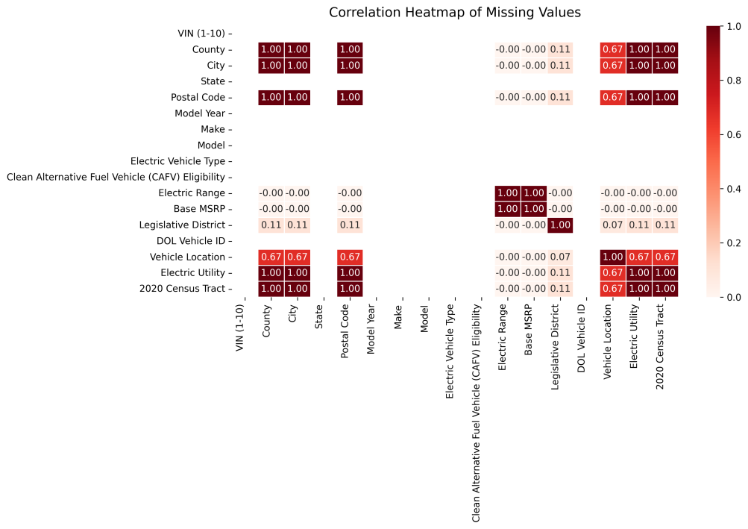
MISSING VALUES
Column Name | Missing Rows
County | 5
City | 5
Electric Range | 19
Base MSRP | 19
Legislative District | 451
Rows with Zero Values:
Base MSRP
Electric Range

Slide 6
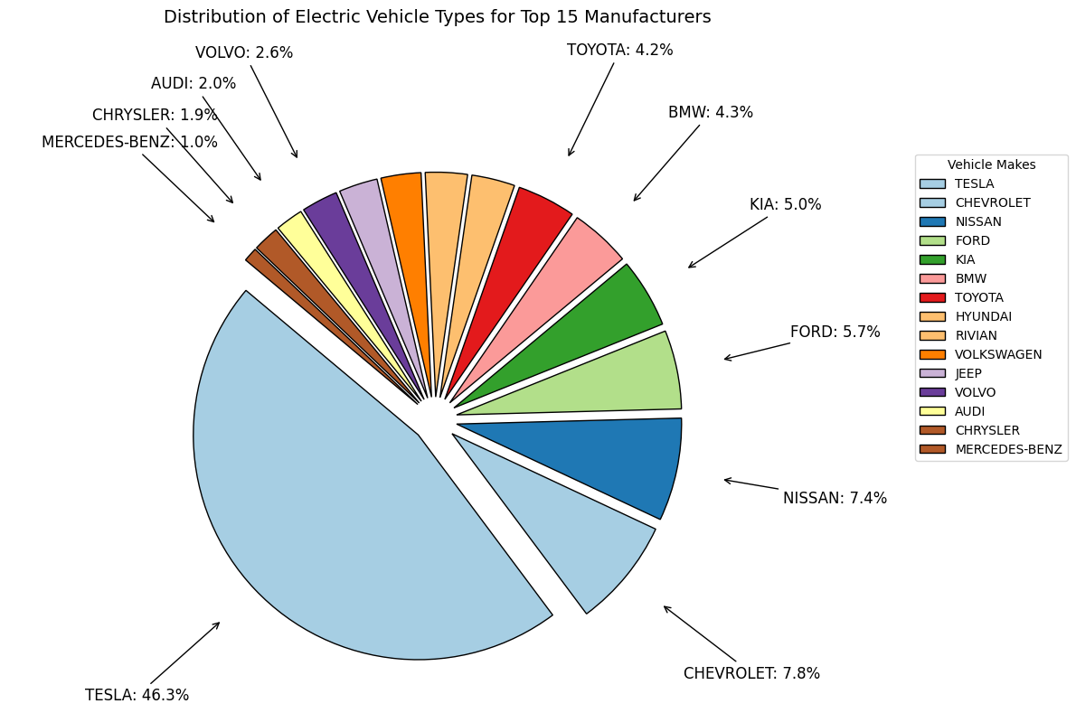
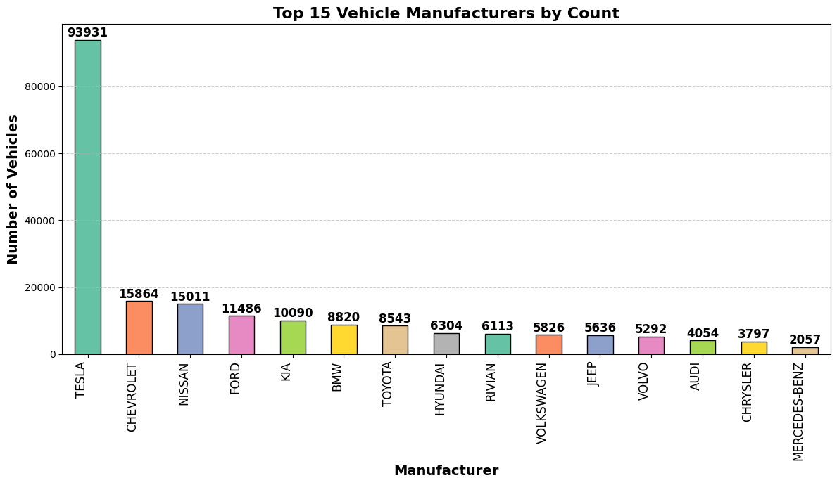
Vehicle Manufacturers
Leading manufactures or Competitors
Manufacturing Capacity

Slide 7
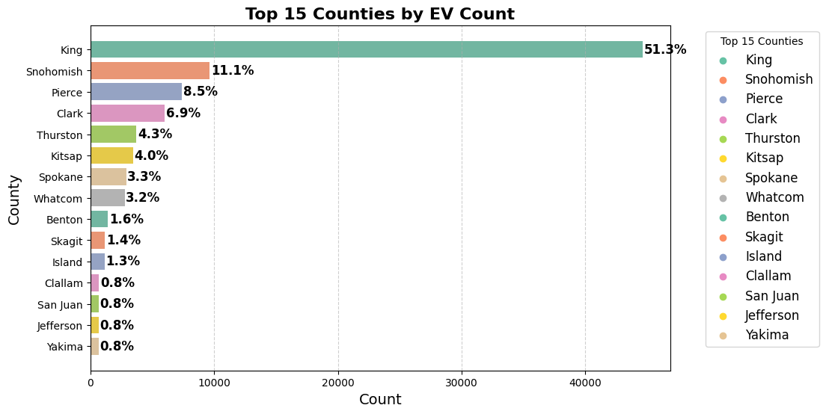
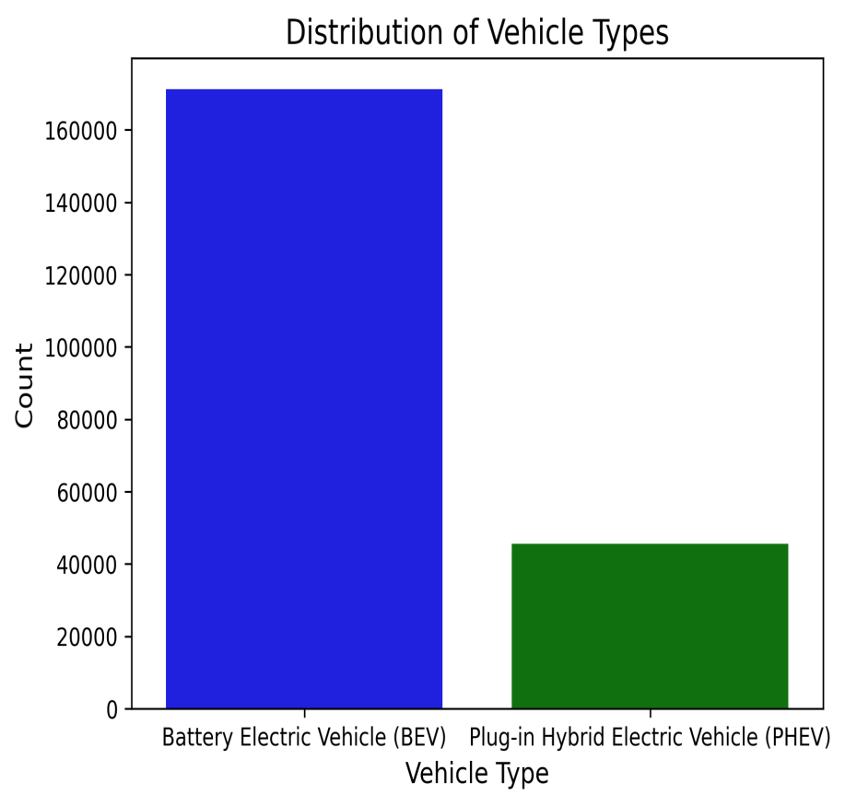
Counties involves major EV adoption
Top 15 counties use EV
BEVs VS PHEVs production

Slide 8
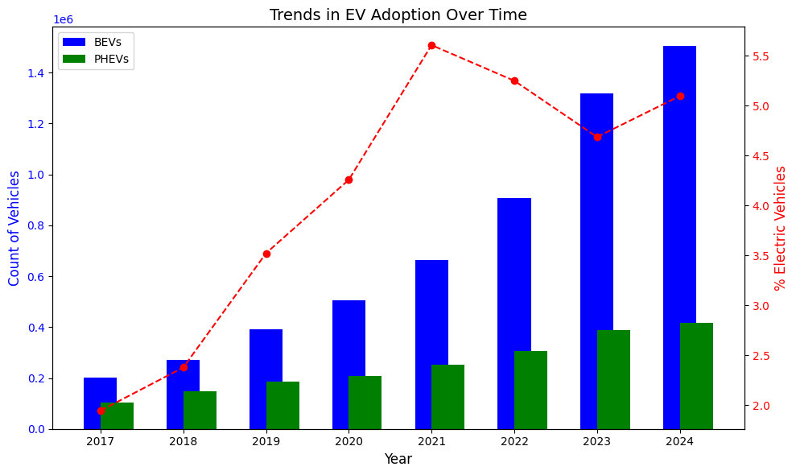
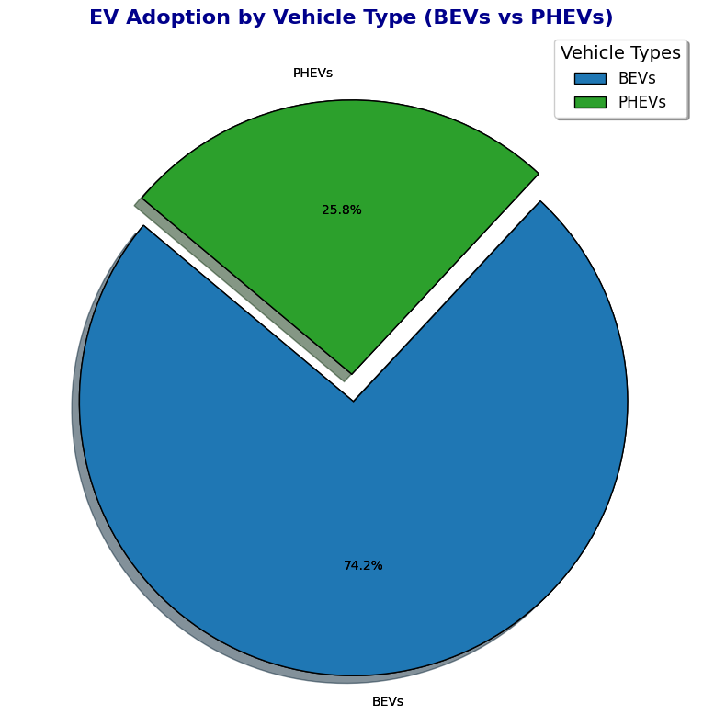
Vehicle Adoption Trends (Yearly)
Adoption Trends(Yearly Insights)
BEVs VS PHEVs adoption

Slide 9
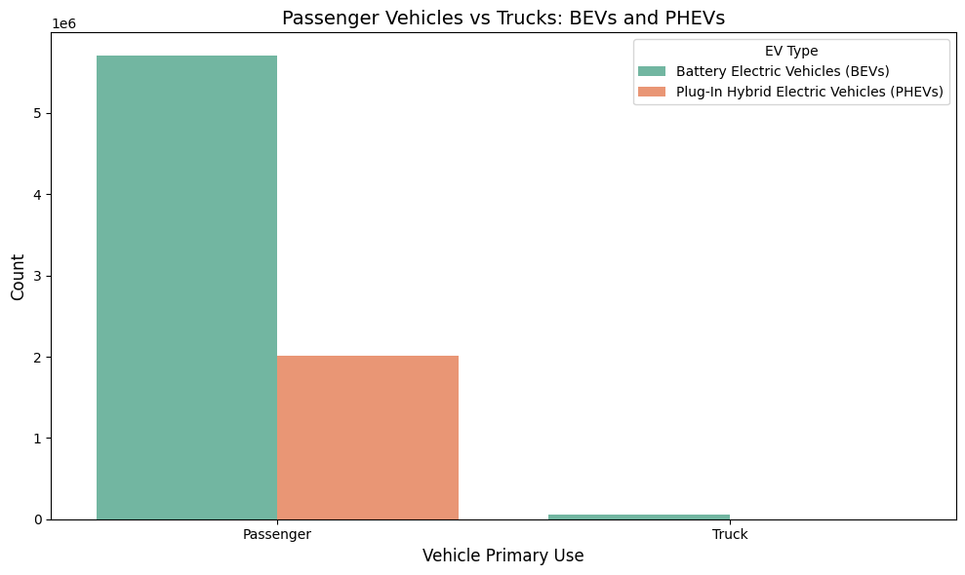

VEHICLE TYPES
Why Passenger Vehicles?
Why Battery Evs

Slide 10
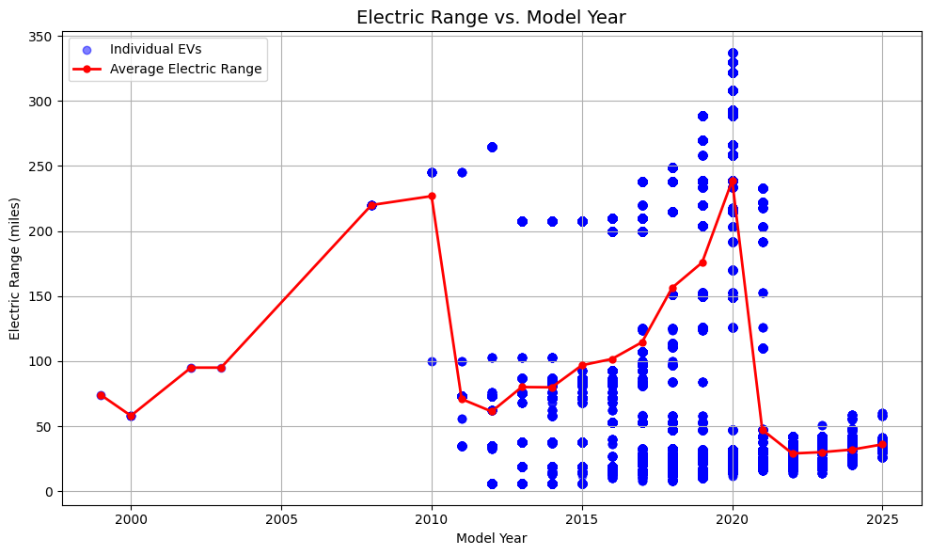
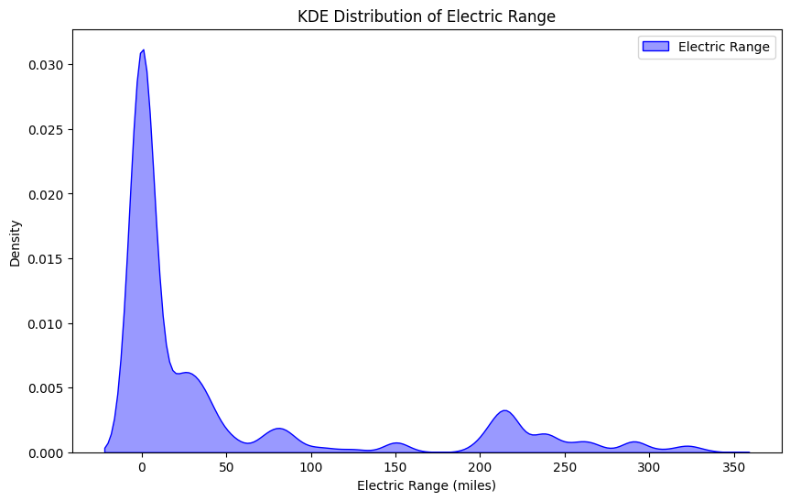
Electric Vehicle Range
Range affects sales?
Evolution of EV technology over the years
Newer vehicles have improved ranges
Range Distribution

Slide 11
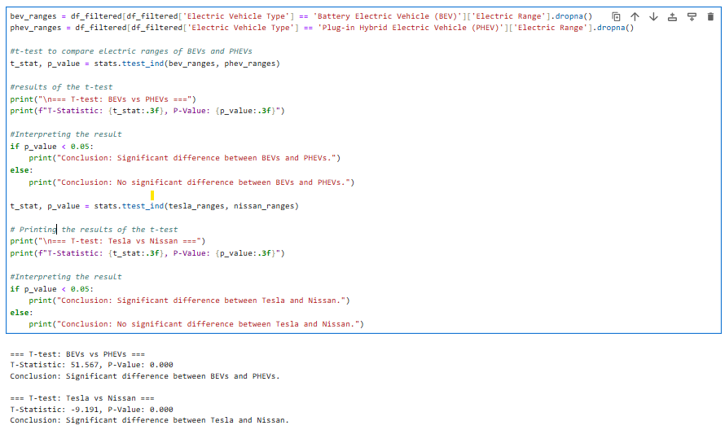
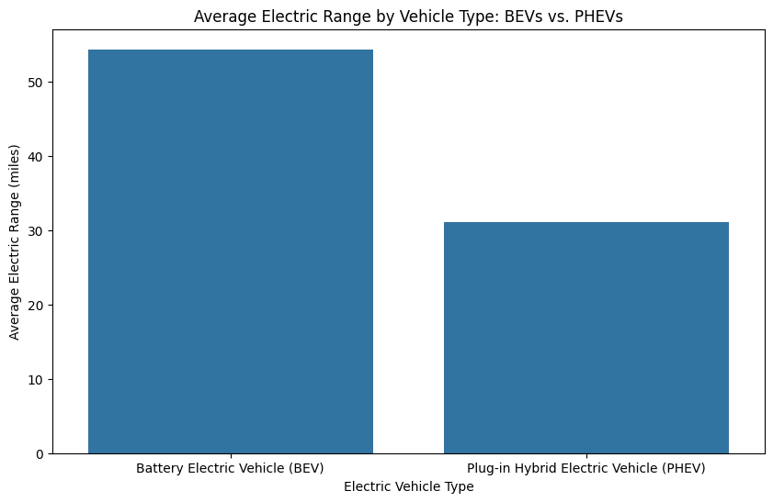
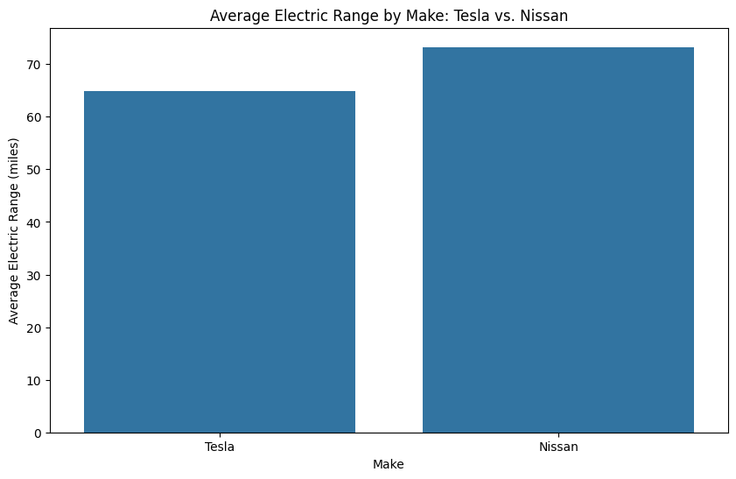
Statistical analysis
Snippet:

Slide 12
Key Insights
EV Distribution by County
EV Usage by Vehicle Type
Trends Over Time
Environmental and Economic Factors

Slide 13
Future Improvements
Market Trends and Consumer Preferences
Collaboration and Partnerships
Consumer Behavior and Education
Public Engagement and Awareness
Sustainability and Environmental Impact

Slide 14
Questions & Discussion:
Any Questions?
Suggestions for Improvement?

Slide 15

THANK YOU ALL

